Slide 1
Think About / For YOURSELF The hardest thing you’ll ever do!

Slide 2


Slide 3
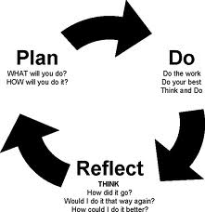
The Thinking Process

Slide 4
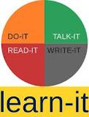
So …

Slide 5
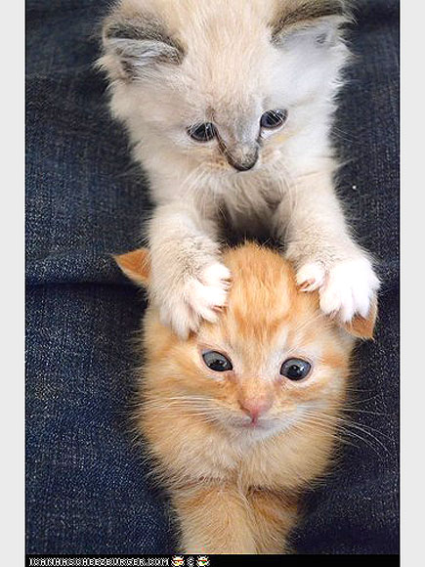
Thinking leads us to look for = s eek knowledge
We are curious
beings and we
need to know
MORE
therefore
let’s put on our
thinking caps!

Slide 6
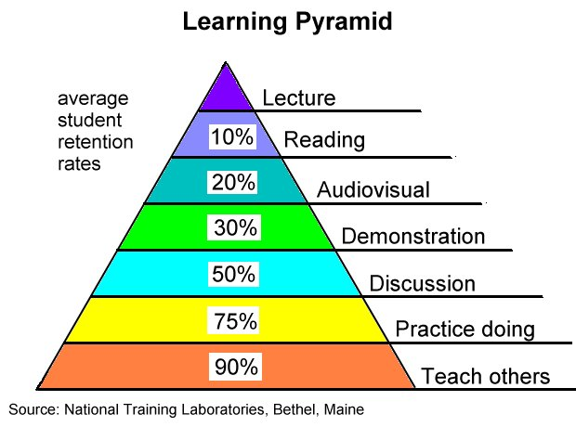
Our Learning Reality

Slide 7

Learning = Understanding?
-
-
-
-
-

Slide 8
Focus On:
English word order
Subject object agreement
Spelling
Verb tenses
Grammatical structures
Vocabulary usage
Phrasal verb usage
Connecting / linking expressions
Transfer of ideas
Your audience
Being true to yourself
Notes:
ob

Slide 9

COMMUNICATION?

Slide 10


Slide 11
The Ingredients to Effective Communication
-
-
-
-
-

Slide 12
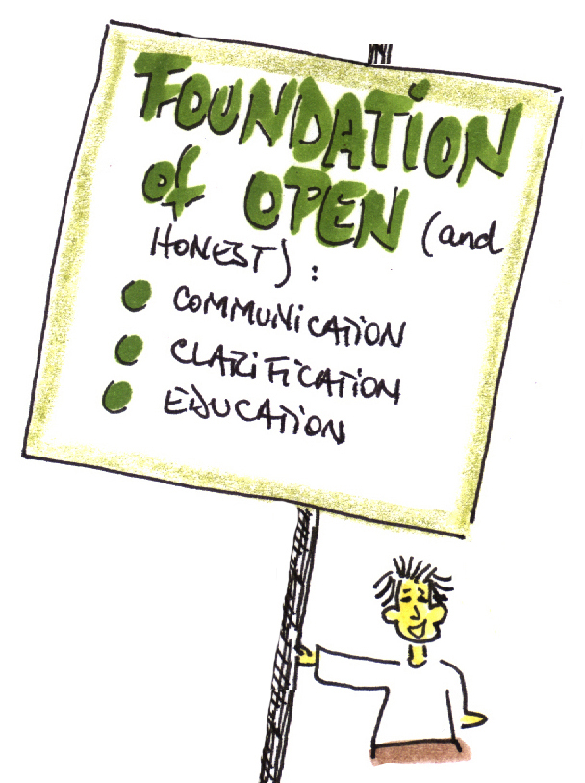

Slide 13
think it through understand it & make it your own communicate it effectively

Slide 14



